Slide 1
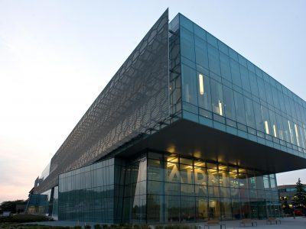
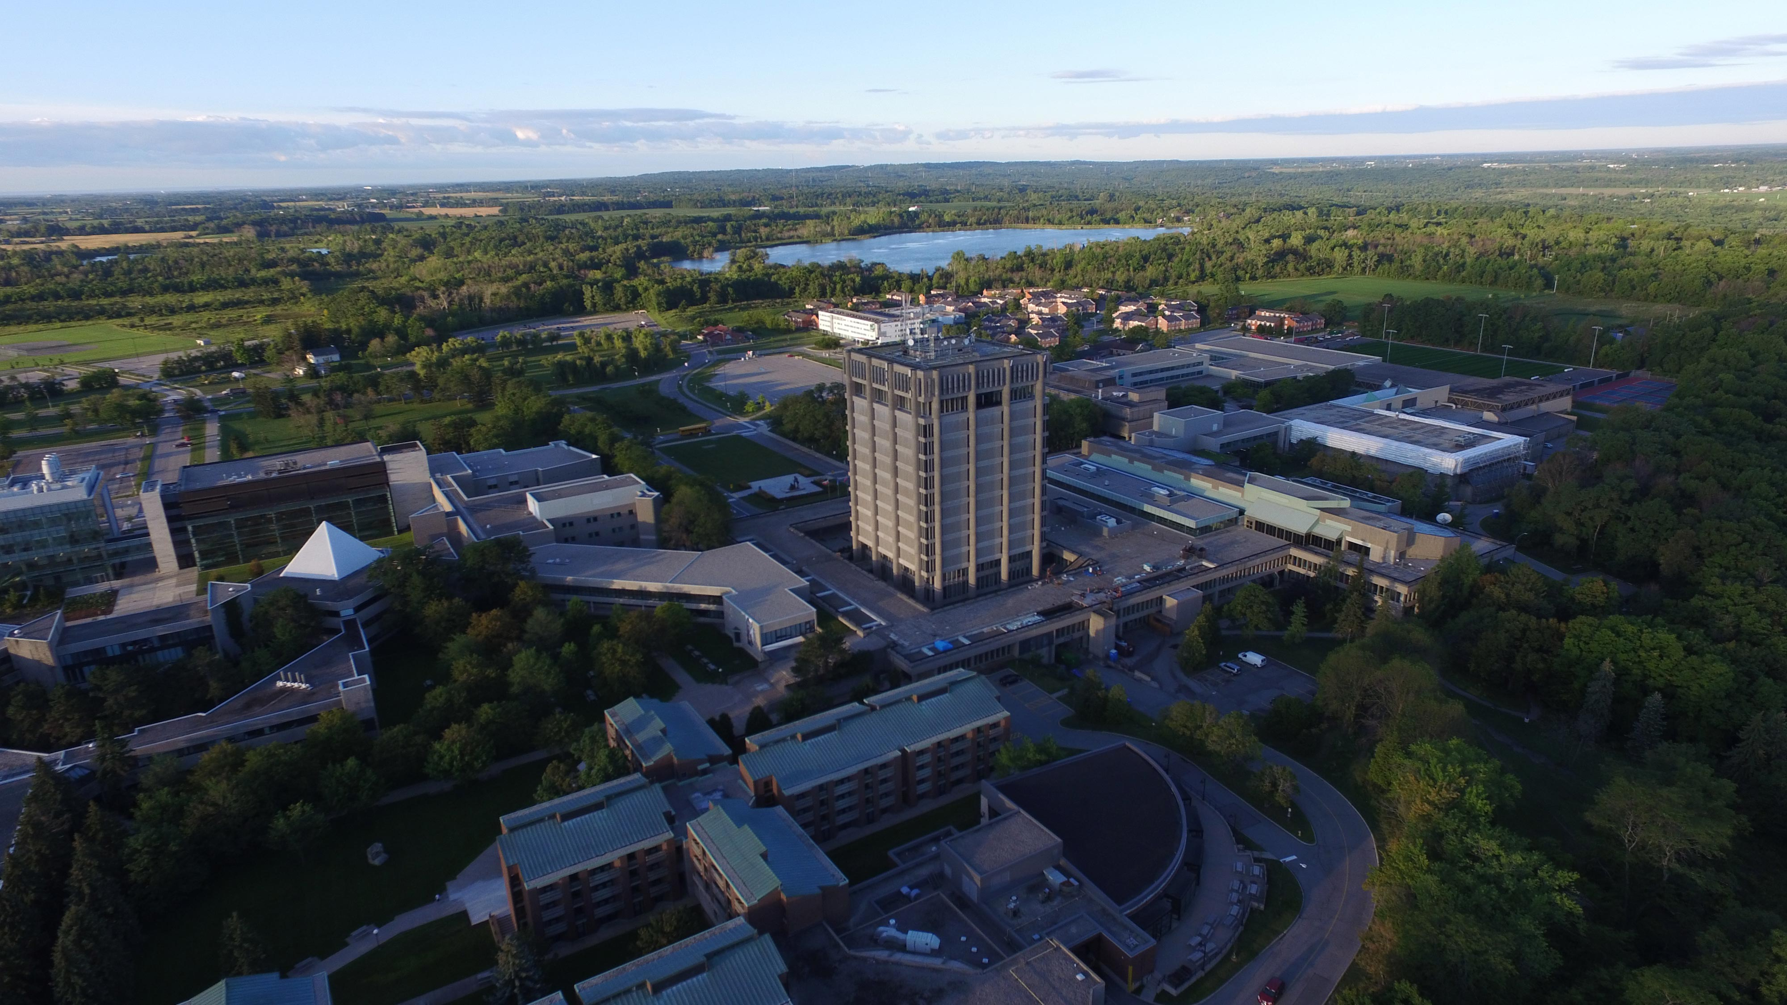
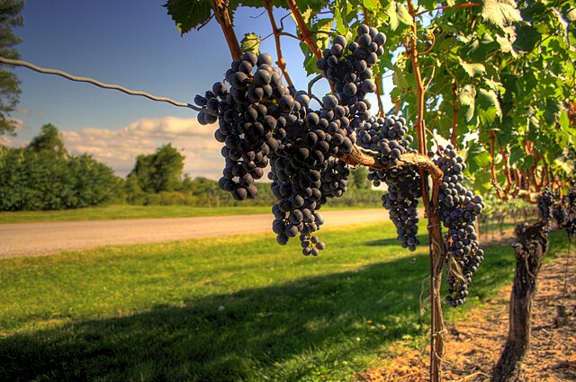
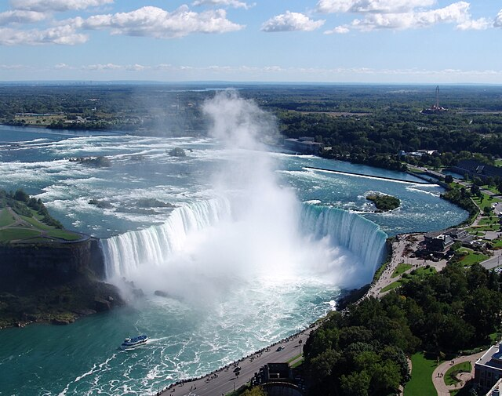
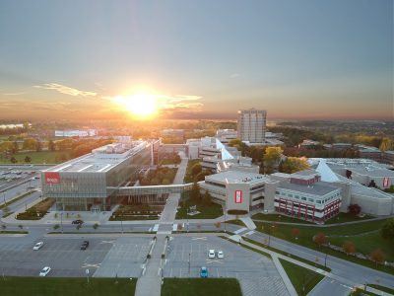
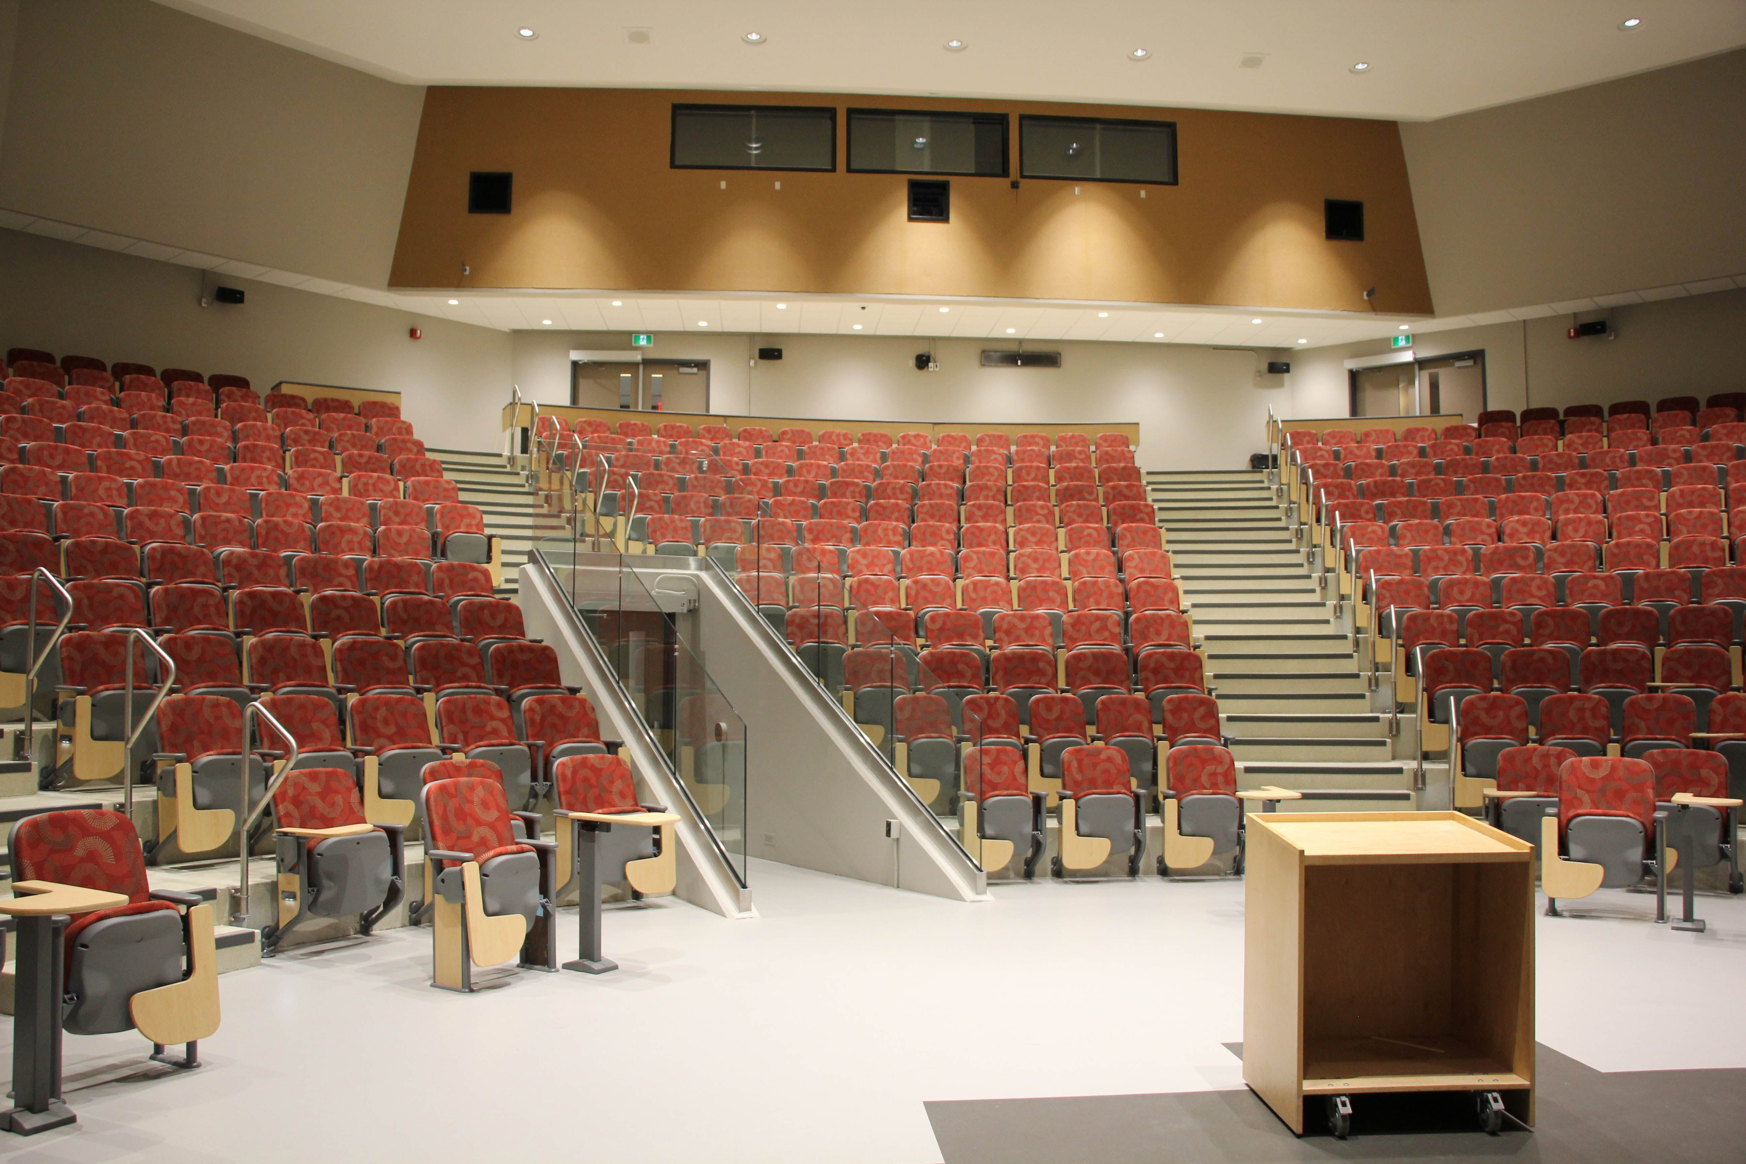
OE3C 2026 April 30- May 2, 2026 Brock University Coexisting with nature: life in the Niagara escarpment biosphere
Notes:
Brock University is located on the Niagara Escarpment, a UNESCO World Biosphere Reserve, one of 12 in Canada
Brock University is located in and near the famous Niagara, Niagara on the Lake, and the Bench wine growing and wine making areas
Brock University is near the beautiful Canadian side of Niagara Falls
We welcome you May 7-9, 2026. Look forward to workshops, evening socials, networking opportunities, and of course – amazing science!
Please note, this is not the official theme, just something that can be explored!
See you next year!

Slide 2
OE3C 2026 April 30- May 2, 2026 Brock University Coexisting with nature: life in the Niagara escarpment biosphere
Notes:
Brock University is located on the Niagara Escarpment, a UNESCO World Biosphere Reserve, one of 12 in Canada
Brock University is located in and near the famous Niagara, Niagara on the Lake, and the Bench wine growing and wine making areas
Brock University is near the beautiful Canadian side of Niagara Falls
We welcome you May 7-9, 2026. Look forward to workshops, evening socials, networking opportunities, and of course – amazing science!
Please note, this is not the official theme, just something that can be explored!
See you next year!

Slide 3
OE3C 2026 April 30- May 2, 2026 Brock University Coexisting with nature: life in the Niagara escarpment biosphere
Notes:
Brock University is located on the Niagara Escarpment, a UNESCO World Biosphere Reserve, one of 12 in Canada
Brock University is located in and near the famous Niagara, Niagara on the Lake, and the Bench wine growing and wine making areas
Brock University is near the beautiful Canadian side of Niagara Falls
We welcome you May 7-9, 2026. Look forward to workshops, evening socials, networking opportunities, and of course – amazing science!
Please note, this is not the official theme, just something that can be explored!
See you next year!

